Slide 1
Prevent User Deletion If Assigned To An Incident
SlideMake.com

Slide 2

Introduction to User Deletion Prevention
Preventing user deletion is critical to maintaining data integrity in incident management systems.
Users assigned to incidents play a vital role in ensuring timely resolution and accountability.
This presentation explores strategies to prevent deletion of users who are actively assigned to incidents.
Notes:
Image source: https://www.slidemake.com

Slide 3
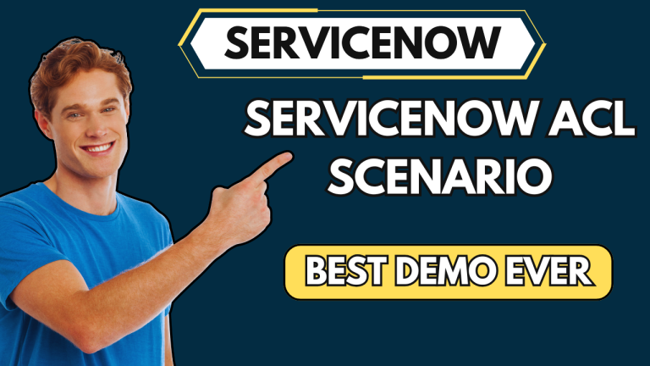
Importance of Protecting Assigned Users
Protecting assigned users helps preserve the audit trail and accountability within the system.
Deleting users who are assigned to incidents can lead to data inconsistencies and loss of historical records.
Ensuring user integrity promotes trust and reliability in incident management processes.
Notes:
Image source: https://servicenowspectaculars.com

Slide 4

Common Risks of User Deletion
Deleting assigned users may cause orphaned incident records and broken links.
It can complicate reporting and hinder incident resolution tracking.
Unauthorized or accidental deletions may compromise security and compliance standards.
Notes:
Image source: https://spgeeks.devoworx.com

Slide 5
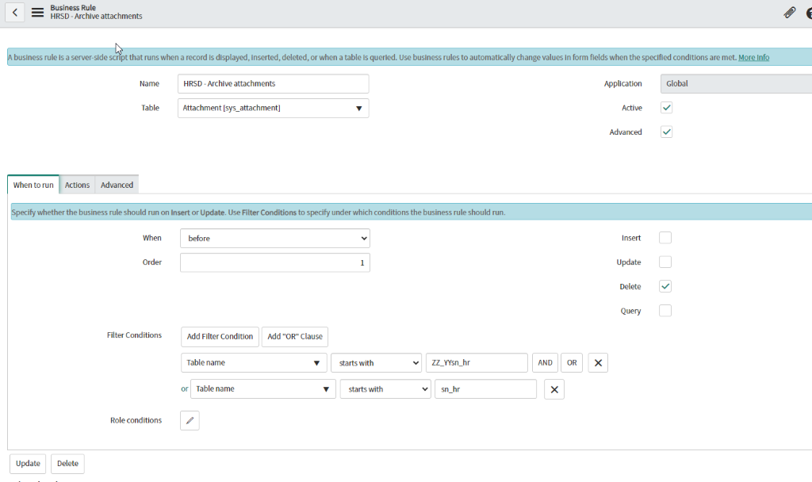
System Configuration for Prevention
Many platforms offer configuration options to restrict user deletion when assigned to active incidents.
Implementing role-based access controls can limit deletion rights for sensitive users.
Custom scripts and workflows can be created to automatically prevent deletion under specific conditions.
Notes:
Image source: https://incident.do

Slide 6
Using Business Rules and Workflows
Business rules can be designed to check for active incident assignments before allowing user deletion.
Workflows can prompt administrators to reassign or deactivate users instead of deleting them.
Automating these checks reduces human error and enforces consistency in user management.
Notes:
Image source: https://www.slidemake.com

Slide 7
Best Practices for Administrators
Regularly review user access and assignment statuses to prevent accidental deletions.
Maintain clear documentation and policies regarding user management and incident assignments.
Train administrators on system features and the importance of safeguarding assigned users.
Notes:
Image source: https://incident.do

Slide 8
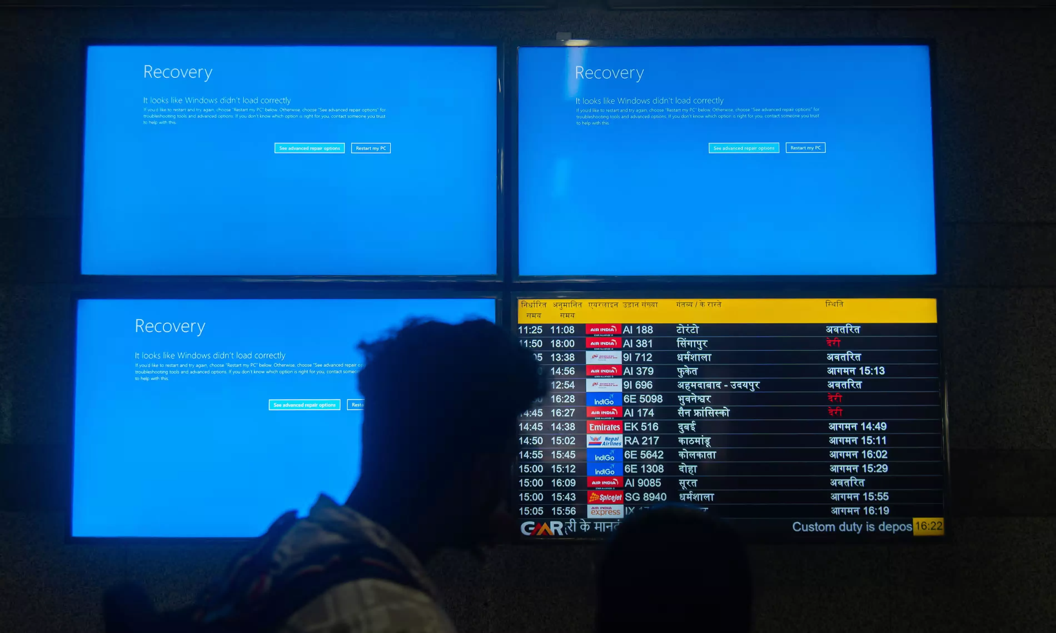
Benefits of Prevention Measures
Enhances data integrity and maintains a complete incident history.
Improves system security by preventing unauthorized deletions.
Supports compliance with organizational and regulatory standards.
Notes:
Image source: https://www.techspot.com

Slide 9
References
[Insert relevant documentation, guides, or official platform resources here.]
[Include best practice articles or vendor recommendations.]
[Add links to community forums or expert blogs related to incident management and user protection.]

